Slide 1
PROJECT
EMPLOYEE ABSENTEEISM ANALYTICS

Slide 2
PROJECT
EMPLOYEE ABSENTEEISM ANALYTICS

Slide 3
Steps
Generate Models
Process
Add more data
.csv
Clean
XL Analysis
Import to R
Coordinates DB
Dump
+ Justification

Slide 4
Steps

Slide 5
Steps

Slide 6
Data Cleaning

Slide 7
Data
Cleaning

Slide 8
Data
Cleaning
Age ends
Duplicate Values
Unknown Cities

Slide 9
Organizational Chart
CEO
CIO
VP Finance
VP Human Resources
VP Stores
Exec Assistant, Finance
Exec Assistant, Human Resources
Exec Assistant, VP Stores
Director, Audit
Director, Investments
Director, Accounting
Director, Accounts Payable
Director, Accounts Receivable
Director, Training
Director, Compensation
Director, Labor Relations
Director, Recruitment
Director, Employee Records`
Director, HR Technology
Store Manager
Customer Service Manager
Produce Manager
Processed Foods Manager
Dairy Manager
Meats Manager
Bakery Manager
Systems Analyst
Cashier
Produce Clerk
Shelf Stocker
Dairy Person
Meat Cutter
Baker
Trainer
Compensation Analyst
Labor Relations Analyst
Recruiter
Benefits Admin
HRIS Analyst
Auditor
Investment Analyst
Accounting Clerk
Accounts Payable Clerk
Accounts Receiveable Clerk
Exec Assistant, Legal Counsel
Legal Counsel
Corporate Lawyer

Slide 10
Organizational Chart
CEO
CIO
Legal Counsel
Exec Assistant, Legal Counsel
Systems Analyst
Corporate Lawyer
VP Finance
VP Human Resources
VP Stores
Exec Assistant, Finance
Exec Assistant, Human Resources
Exec Assistant, Human Resources
Exec Assistant, VP Stores
Director, Audit
Director, Investments
Director, Accounting
Director, Accounts Payable
Director, Accounts Receivable
Director, Training
Director, Compensation
Director, Labor Relations
Director, Recruitment
Director, Employee Records`
Director, HR Technology
Auditor
Investment Analyst
Accounting Clerk
Accounts Payable Clerk
Accounts Receiveable Clerk
Trainer
Compensation Analyst
Labor Relations Analyst
Recruiter
Benefits Admin
HRIS Analyst
Store Manager
Customer Service Manager
Produce Manager
Processed Foods Manager
Dairy Manager
Meats Manager
Bakery Manager
Cashier
Produce Clerk
Shelf Stocker
Dairy Person
Meat Cutter
Baker

Slide 11
Gender equity

Slide 12
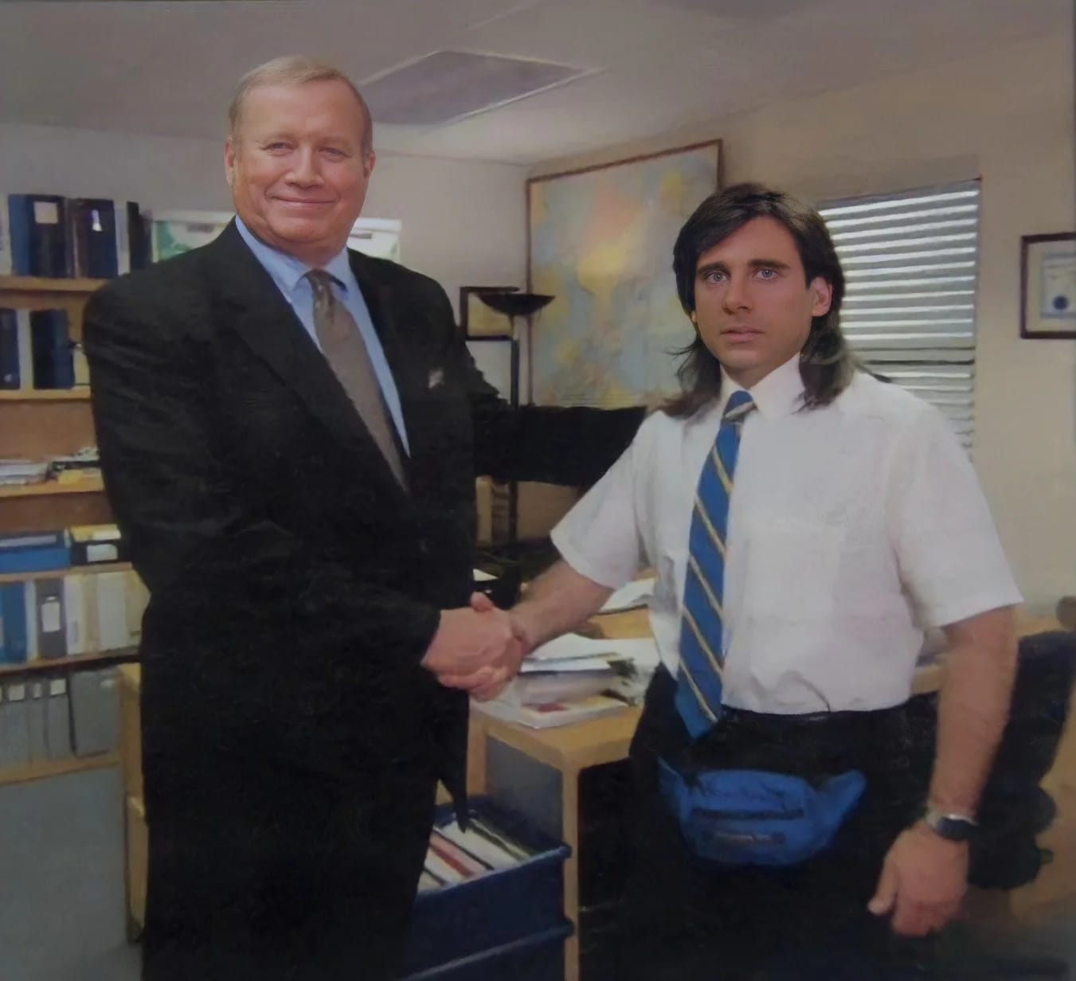
Gender Equality
Random Fictitious Data

Slide 13
Highest Jobs in Tenure

Slide 14
PROJECT
EMPLOYEE ABSENTEEISM ANALYTICS

Slide 15
Data Cleaning

Slide 16
Data Cleaning

Slide 17
Data Cleaning

Slide 18
Steps

Slide 19
Steps

